Slide 1
Wishbone
Wishbone – Target Chat Bot

Slide 2
Where are our guests when they are not at Target?

Slide 3
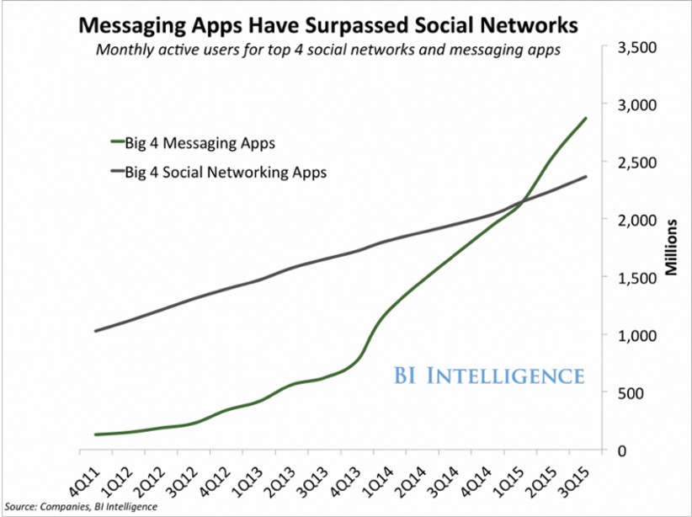
Conversational Commerce
“Millennials prefer text-based communication and absolutely despise waiting on the phone”
- Forbes
Wishbone allows Target to conduct one-on-one conversations with our guests in real time. Helping them by answering questions and finding products.
Allows Target to communicate with guests without being on one of Targets native apps or website
Notes:
Millennials who used to seek out data on Google, are now moving to messaging apps to get their answers in a real-time, seamless way.
While Target may find it challenging to convince consumers to download their standalone retail app, they have a lot of opportunity to connect with shoppers through messaging. With so many consumers using messaging apps every day, chatbots and conversational commerce help businesses be where their customers are.

Slide 4
Demo

Slide 5
Our Goal (Target)
Millennials
Content Distribution
Where and how we meet guests
Localization and Personalization
Notes:
We want to meet guests where people are
We want to give them a great user experience where they are getting information how and where they want it
We want to target the millennial customer who is different in their social matters and preferences than past generations
The more contact you have with guests or the easier Target makes it to readily shop with Target the more sales Target will have moving forward.

Slide 6
What’s Next
Virtual Intelligence
Buying products with messenger
Data aggregation and machine learning

